Slide 1
FPGA Vehicle Plate Reader
Team NSA: Darrin Ginoza, Jack Abernathy, Joe Squeri,
Patrick Murphy, Ravi Darbha

Slide 2
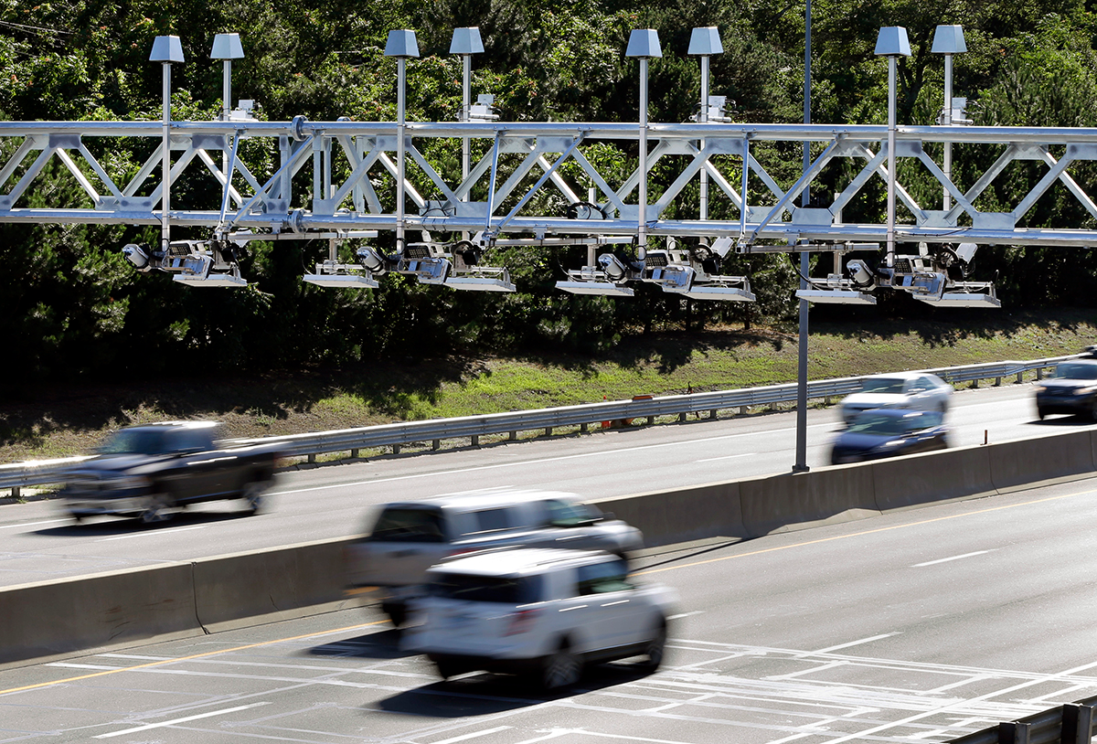
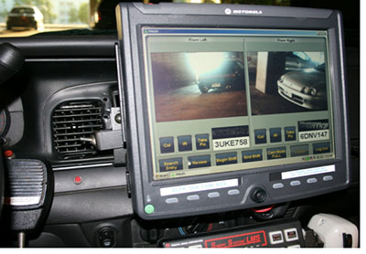
Project Motivation
The objective of this project is the development of a FPGA based vehicle plate recognition system. Currently vehicle plate recognition is an essential part of the infrastructure found in vehicle based systems concerning electronic payment, restricted area access, and the identification of criminal activities. FPGA based designs provide the ability for high performance recognition systems that are both low power and low latency.
Notes:
Images: https://www.eff.org/files/images_insert/alpr_monitor.jpg, http://cdn1.bostonmagazine.com/wp-content/uploads/2016/08/mass-pike-toll-gantries.jpg

Slide 3
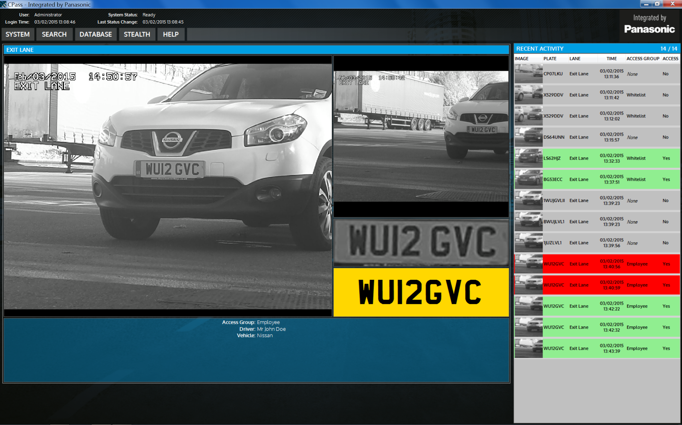
Functionality - Overview
Capture video from camera
Process frames using edge detection
Segment license plate characters
Do character recognition on segments
Display image processing output via VGA
Switchable to display output of character recognition
Notes:
Image from: http://business.panasonic.co.uk/security-solutions/security-technology/anpr-technology

Slide 4
Specification Overview
We based our design on standard six-digit Massachusetts license plates
Our segmentation implementation requires the plates to be approximately 18 inches in front of camera
Character recognition is currently implemented on a numerical dictionary

Slide 5
System Level Diagram
RGB444 -> YUV -> RGB444
RGB565 pixel
RGB444 pixel
RGB444 pixel (Filtered)
RGB444 pixel (Filtered)
RGB444 pixel for related to camera or character
RGB444 pixel (for digit character)
Images: https://en.wikipedia.org/wiki/Kernel_(image_processing)

Slide 6
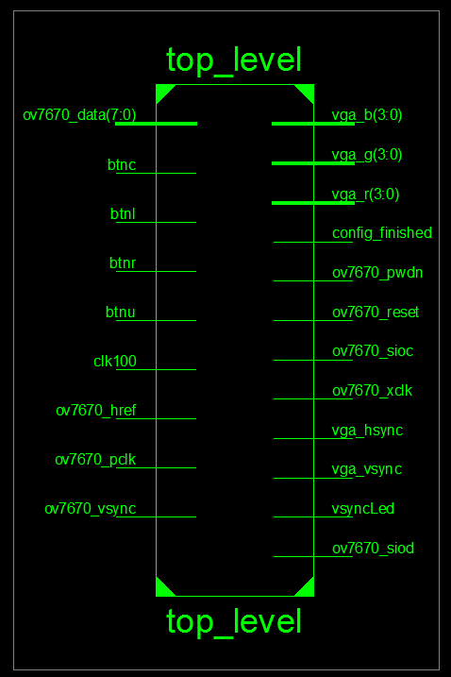
RTL Overview

Slide 7
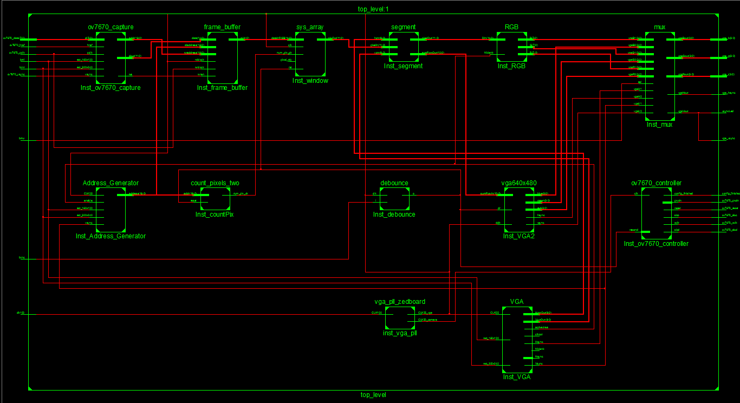

Slide 8
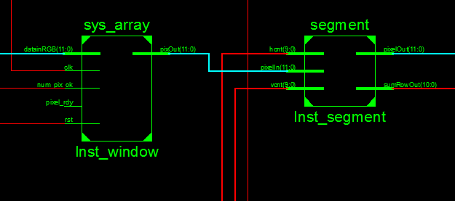
RTL Overview
VGA_segment
Frame Buffer
VGA_OCR
Data Counter

Slide 9
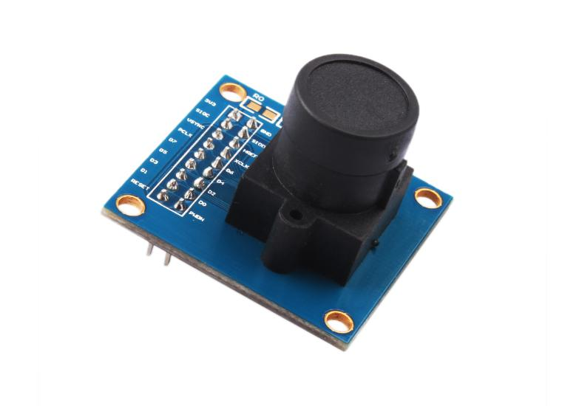
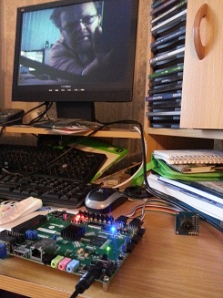
Camera Controller
OV7670 camera - low voltage CMOS image sensor capable of operating up to 30 frames per second.
For our camera controller we modified existing code that interfaced the camera with the Zedboard found at: http://hamsterworks.co.nz/mediawiki/index.php/Zedboard_OV7670
Notes:
Camera iamge: http://www.elecfreaks.com/store/ov7670-camera-module-p-705.html
Second image/Code available at: http://hamsterworks.co.nz/mediawiki/index.php/Zedboard_OV7670

Slide 10
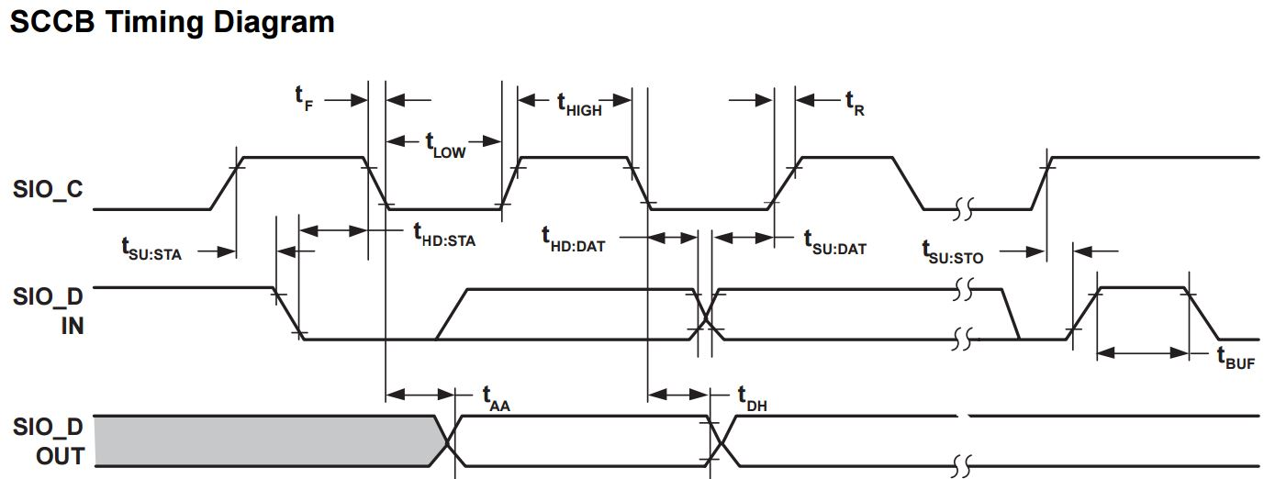
Camera Controller - Capturing Pixels
Camera provides full framed images (640 x 480 pixels) controlled through the Serial Camera Control Bus (SCCB) interface which is compatible with an I2C interface
The camera transfers individual pixels in RGB565 format (Red: 5 bits, Green: 6 bits, Blue: 5 bits). Pixel data is streamed in row by row.
Our camera controller captures the pixel data provided by the camera and truncates it to RGB444 format (Red: 4 bits, Green: 4 bits, Blue: 4 bits) before passing data onto the frame buffer.
Notes:
Information and image from camera datasheeet: http://www.voti.nl/docs/OV7670.pdf

Slide 11
Camera Controller - Frame Buffer
An IP core is used to buffer incoming frames. The frame buffer is capable of holding one entire frame (640 x 480 = 307,200 pixels) at once.
This is a total of 460,800 bytes as our pixels are 12 bits each.
As a new frame is streamed in, it begins to overwrite the previous frame saved in the frame buffer

Slide 12

Window Operator - Kernel Convolution
Notes:
Darin
Image: https://developer.apple.com/library/content/documentation/Performance/Conceptual/vImage/Art/kernel_convolution.jpg

Slide 13
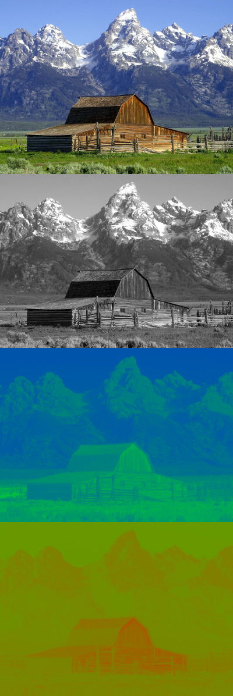
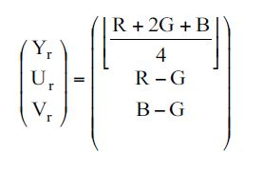
Window Module - Preprocessing
Original
Pixels are passed from the frame buffer into our window module.
Before performing any windowing operation, the RGB pixel is converted to grayscale:
Y
U
V
M. Po-Leen Ooi (2006) “Hardware Implementation for Face Detection on Xilinx Virtex-II FPGA using
the Reversible Component Transformation Colour Space”v Electronic Design, Test and Applications, 2006. DELTA 2006. Third IEEE International Workshop on
Notes:
YUV image from: https://en.wikipedia.org/wiki/YUV

Slide 14
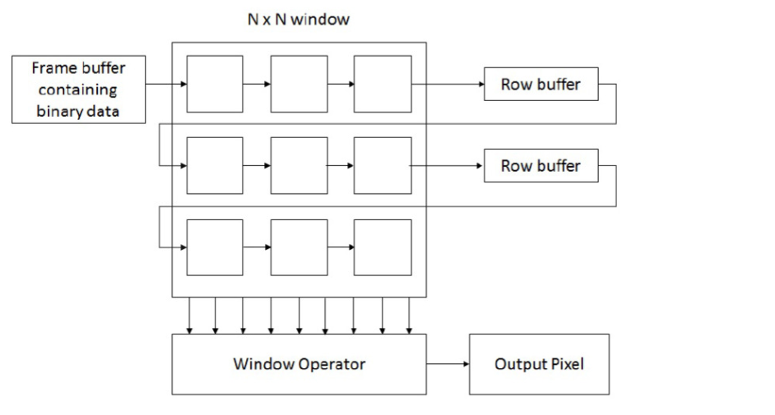
Window Module - Design
Our window module uses a 3x3 window to perform image processing.
To ensure the proper pixels are used in our window operation, two FIFO queues (row buffers) are used in conjunction with our window. These are necessary as pixel data streams in row by row.
C. Supe, (2014) “Real Time Implementation of Spatial Filtering on FPGA”, Advances in Vision Computing, vol. 1, no. 4 December 2014.

Slide 15

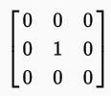
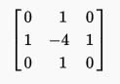
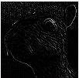
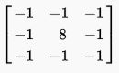
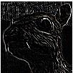
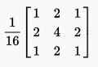

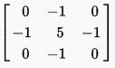
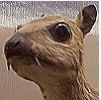
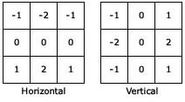
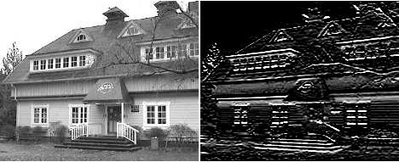
Window Operators
Experimented with a various window operations, as well as combining multiple operations:
Edge Detectors (Laplacian Spatial Filter):
Gaussian Blurring (Noise Reduction):
Sharpening:
Sobel Filters:
Notes:
Identity, Edge, Blurring, Sharpening Images: https://en.wikipedia.org/wiki/Kernel_(image_processing)
Sobel Images: http://www.aishack.in/tutorials/image-convolution-examples/

Slide 16
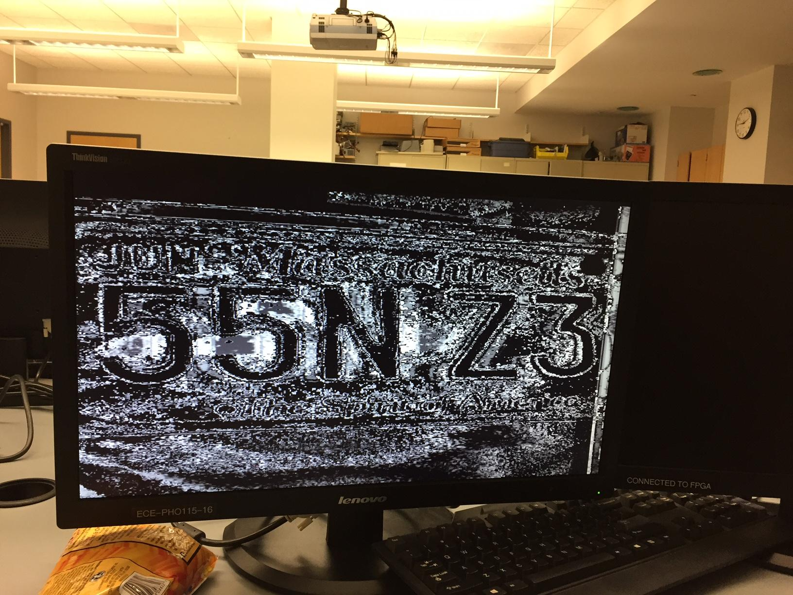
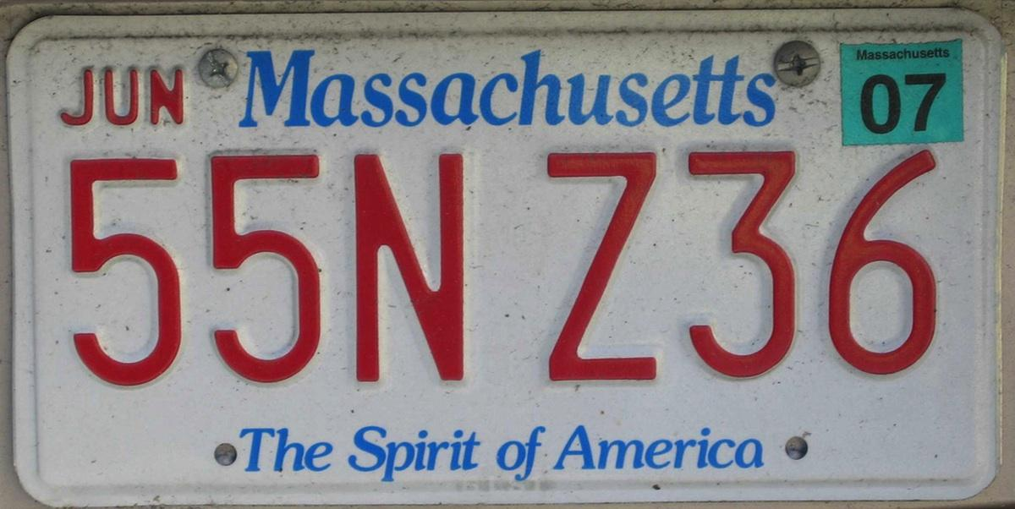
Window Operator - Edge Detection
Ultimately found the below edge detection kernel provided the best results for purposes:
* =
However noise is still a significant issue
Notes:
Original plate: http://cdn1.bostonmagazine.com/wp-content/uploads/2014/10/plate-2.jpg
Kernel: https://en.wikipedia.org/wiki/Kernel_(image_processing)

Slide 17
Verilog Example - Window Module
assign Y = (datainRGB[11:8] + 4'd2*datainRGB[7:4] + datainRGB[3:0])/4'd4; // Convert RGB pixel to grayscale, Y will be 4 bit value
assign Ur = datainRGB[11:8] - datainRGB[7:4];
assign Vr = datainRGB[3:0] - datainRGB[7:4];
assign datain = {Y,Ur,Vr};
// Setup our flip-flops to hold pixels in the window and fifo queues. 3x3 window operation used.
// Inputs to each flip-flop used for kernel convolution operation.
Dff dff1(prevPixels[0], datain, clk, reset);
Dff dff2(prevPixels[1], prevPixels[0], clk, reset);
Dff dff3(prevPixels[2], prevPixels[1], clk, reset);
// FIFOs of length 636 used (RowLength - 1). 636 used instead of 637 to correct clocking issues found in test benches
nFIFO #(.fifosize(636)) fifo1 (prevPixels[2], reset, clk, queue1out);
Dff dff4(prevPixels[3],queue1out, clk, reset);
Dff dff5(prevPixels[4], prevPixels[3], clk, reset);
Dff dff6(prevPixels[5], prevPixels[4], clk, reset);
nFIFO #(.fifosize(636)) fifo2(prevPixels[5], reset, clk, queue2out);
Dff dff7(prevPixels[6], queue2out, clk, reset);
Dff dff8(prevPixels[7],prevPixels[6], clk, reset);
Dff dff9(prevPixels[8], prevPixels[7], clk, reset);
Notes:
Patrick

Slide 18
Verilog Example - Window Module
always @ (posedge clk) begin
if (rst) begin
tempOut0 <= 0; // tempOut# holds a multiplication of a pixel with a weight in our kernel
tempOut1 <= 0;
tempOut2 <= 0;
tempOut3 <= 0;
tempOut4 <= 0;
tempOut5 <= 0;
tempOut6 <= 0;
tempOut7 <= 0;
tempOut8 <= 0;
weights[0] <= $signed(-1); // weights[] holds values used in kernel
weights[1] <= $signed(-1);
weights[2] <= $signed(-1);
weights[3] <= $signed(-1);
weights[4] <= $signed(8);
weights[5] <= $signed(-1);
weights[6] <= $signed(-1);
weights[7] <= $signed(-1);
weights[8] <= $signed(-1);
end

Slide 19
Verilog Example - Window Module
else begin
if (pixel_rdy) begin // if a pixel has been received
// multiply pixel in window by appropriate weight. Note 0 added to start of each pixel to maintain sign of pixel
tempOut0 <= $signed(weights[0])*$signed({1'b0,datain[11:8]});
tempOut1 <= $signed(weights[1])*$signed({1'b0,prevPixels[0][11:8]});
tempOut2 <= $signed(weights[2])*$signed({1'b0,prevPixels[1][11:8]});
tempOut3 <= $signed(weights[3])*$signed({1'b0,queue1out[11:8]});
tempOut4 <= $signed(weights[4])*$signed({1'b0,prevPixels[3][11:8]});
tempOut5 <= $signed(weights[5])*$signed({1'b0,prevPixels[4][11:8]});
tempOut6 <= $signed(weights[6])*$signed({1'b0,queue2out[11:8]});
tempOut7 <= $signed(weights[7])*$signed({1'b0,prevPixels[6][11:8]});
tempOut8 <= $signed(weights[8])*$signed({1'b0,prevPixels[7][11:8]});
// tempOut holds the result of our window operation
tempOut <= tempOut0 + tempOut1 + tempOut2 + tempOut3 + tempOut4 +
tempOut5 + tempOut6 + tempOut7 + tempOut8;

Slide 20
Verilog Example - Window Module
if(num_pix_ok)begin // if we've received enough pixels to run the convolution
// Saturation conditions:
// tempOut is a 18 bit number. We need to return an 12 bit pixel to use in our processed image.
// if tempOut is less than 0 we return a black pixel
if($signed(tempOut) < 0)begin
pixOut <= {4'b0000,4'b0000,4'b0000};
end
// if tempOut is greater than 15 we return a white pixel
else if ($signed(tempOut) > 15) begin
pixOut <= {4'b1111,4'b1111,4'b1111};
end
//otherwise (0 < pixel < 15) we return the value of the pixel. Note here we use the grayscale pixel value (Y),
// which is 4 bits, for R, G, and B
else begin
pixOut <= {tempOut[3:0],tempOut[3:0],tempOut[3:0]};
end
end
// otherwise output a black pixel (should result in black rows for first and last rows of processed image
else
pixOut <= {4'b0000,4'b0000,4'b0000};
end

Slide 21
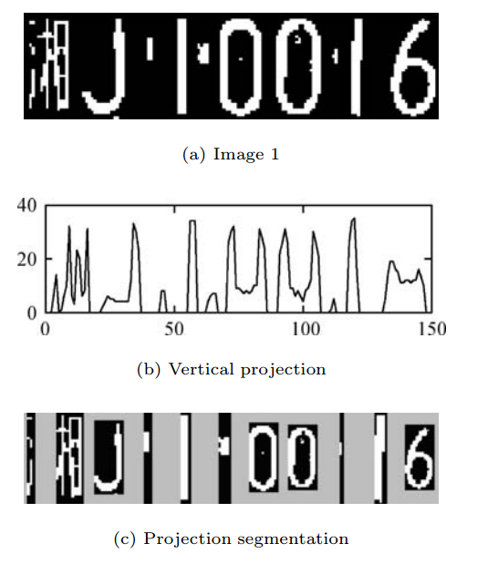
Character Segmentation - Dynamic Implementation
For every frame being streamed in, a horizontal and vertical projection of the number of white pixels is counted
Using the projection, a decision can be made on where to split the frame into segmented images
OCR can then be implemented on each segment
Notes:
Y. Xue, (2014) “Optical Character Recognition”, University of Michigan (https://web.eecs.umich.edu/~girasole/teaching/451/2014fall/gradprojects/optical_character_recognition_final_report.pdf)
Pan, Yan, Xiao (2008) “Vehicle License Plate Character Segmentation” International Journal of Automation and Computing, October 2008, 425-432 DOI: 10.1007/s11633-008-0425-0

Slide 22
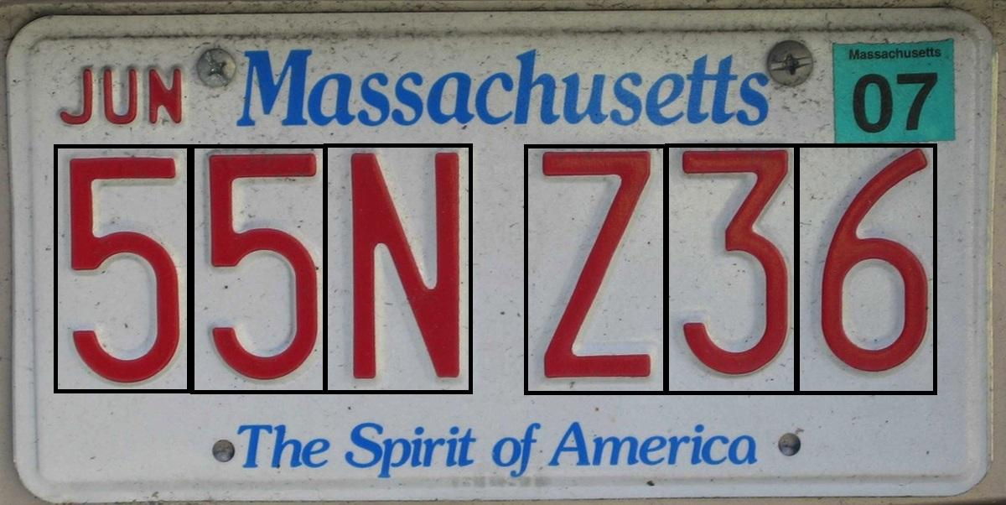
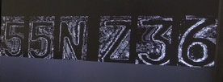
Character Segmentation - Simplified Implementation
Due to time constraints we implemented a simplified character segmentation:
The license plate was assumed to be a fixed size and distance from the camera.
Pixels inside of the segments were retained while pixels outside the segments were made black.

Slide 23
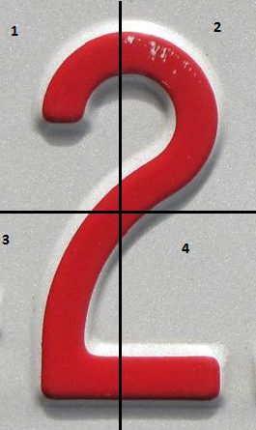
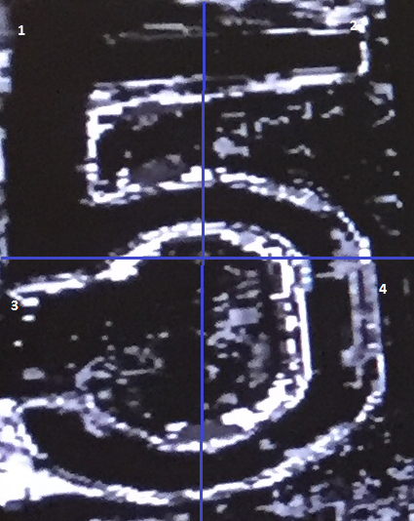
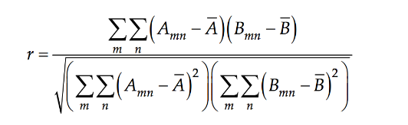
Optical Character Recognition (OCR)
Currently implemented a quadrant system
Add up number of white pixels in each quadrant, and compare them to the pixel count we expect in each quadrant for a specific number.
Working...not so well. See video.

Slide 24
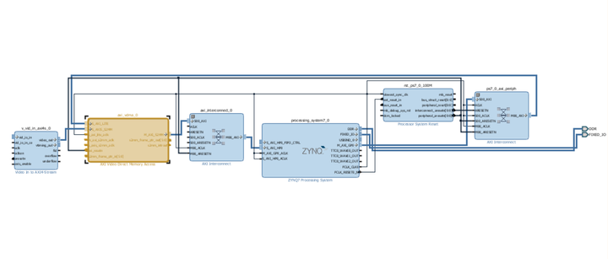
Continuing Efforts
Improving OCR for the demonstration on 12/12.
Piping segmented frame to CPU for recognition.
Get second filter working

Slide 25
Design Tradeoffs
Some loss of complexity
Real time segmentations -> hard coded segmentation
Loss of generalization
Plate needs to be of certain size and distance from camera, only numbers recognizable
Gain of basic functionality of design, proof of concept

Slide 26
Characterization (Timing, Area)
Minimum period: 18.322ns (Max Freq. 53.579MHz)
944 Registers used (~1% utilization)
1,373 LUTs used (~2% utilization)
# RAMB36E1(block ram)/FIFO36E1s used 103 (~73%)

Slide 27
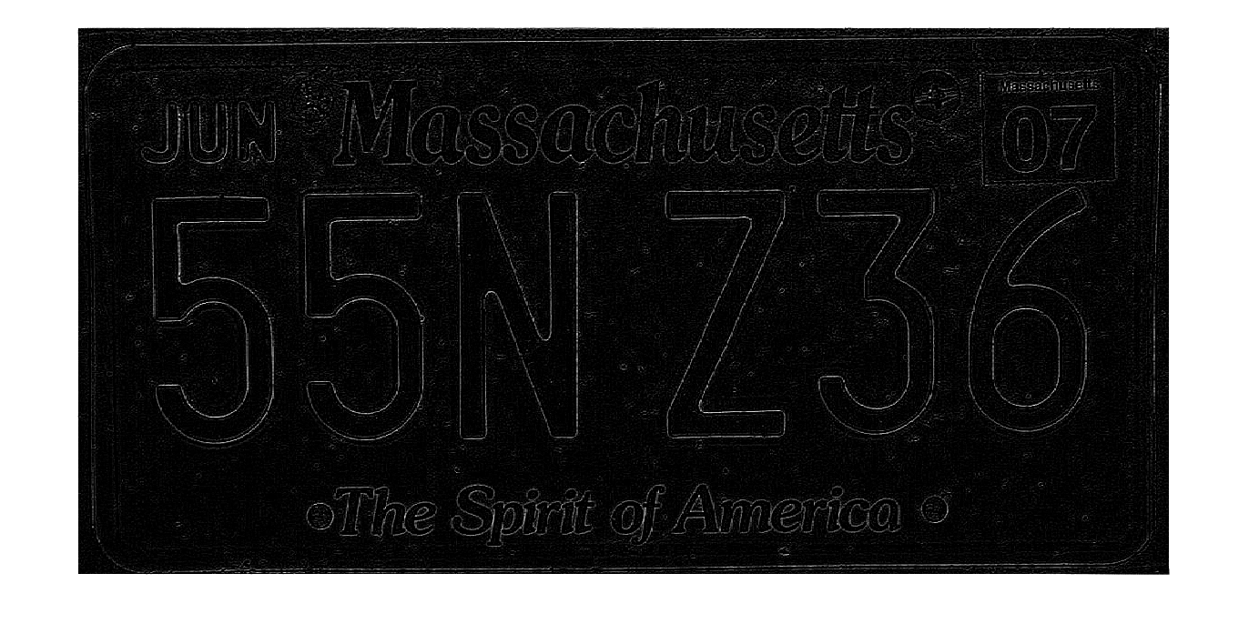
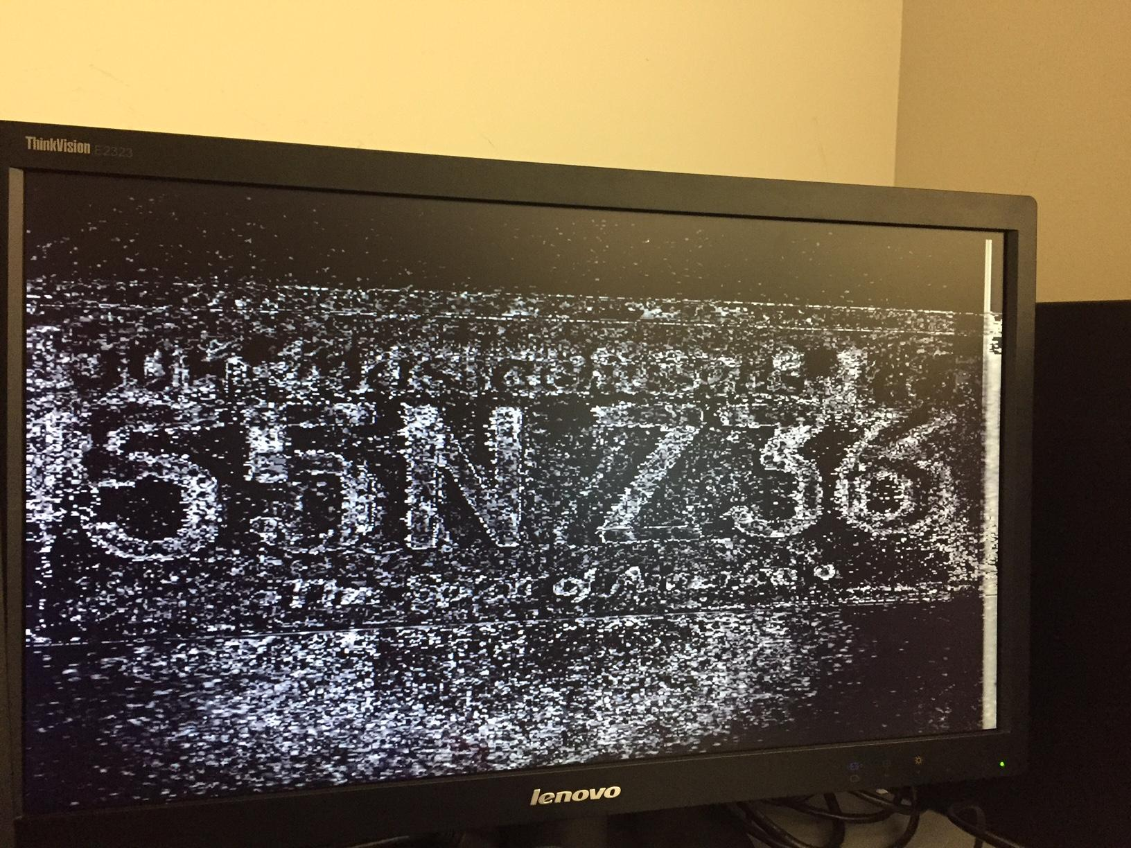
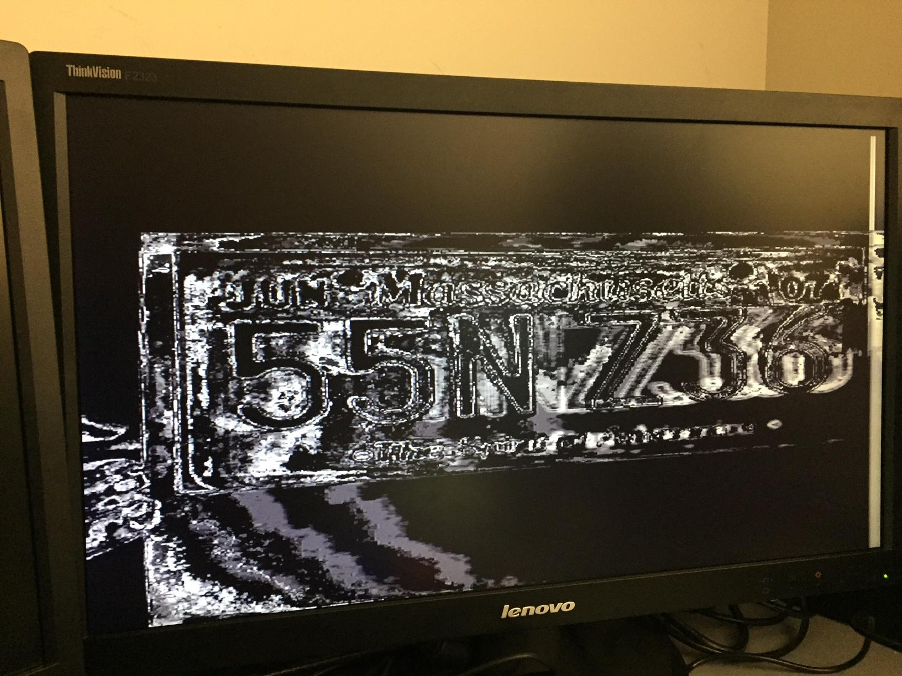
Challenges
Noise
Lighting has a large impact on noise in windowed frames.
Noise makes comparison in OCR difficult due to discrepancies between sampled data and reference data
Timing - making sure everything synced correctly with VGA
Hsync/Vsync/Active Area
Time
Would like to expand on certain features (segmentation, OCR), but difficult to implement a complex design in time allowed
Board breakdown
Ideal Matlab edge detection (Laplacian Kernel)
Effects of low lighting
Effects of direct lighting

Slide 28
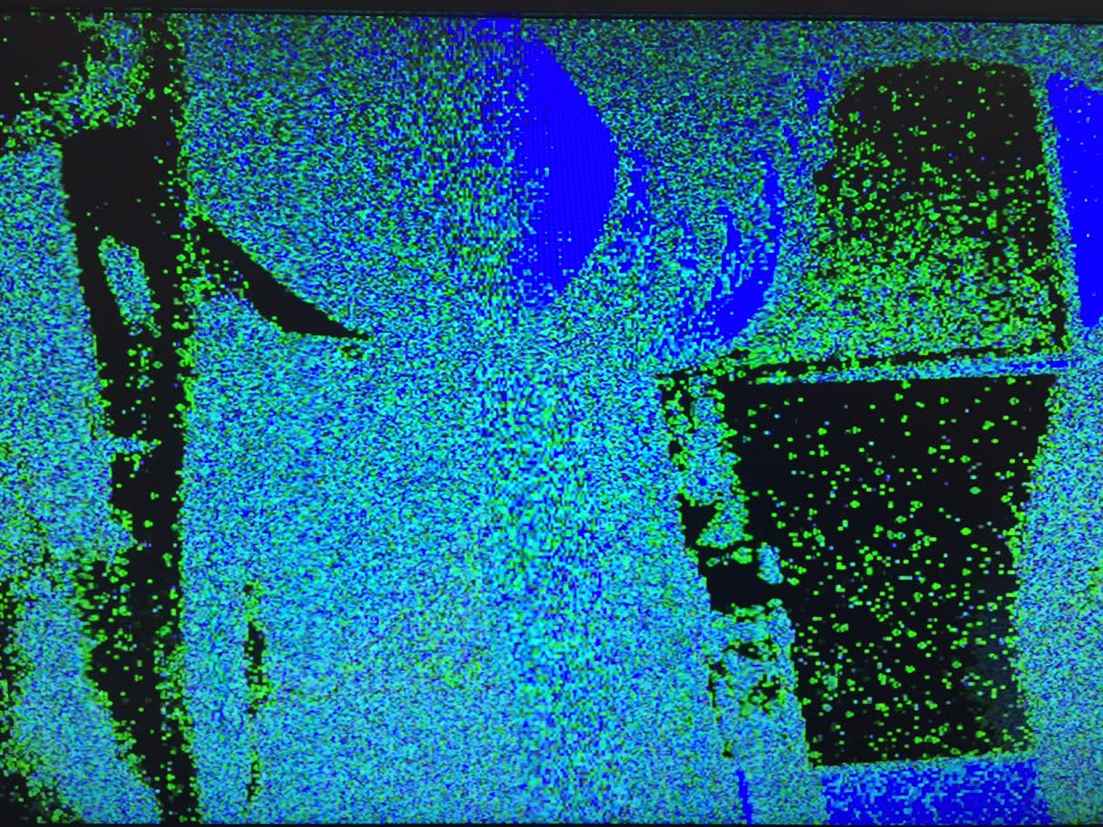
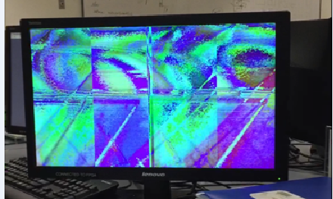
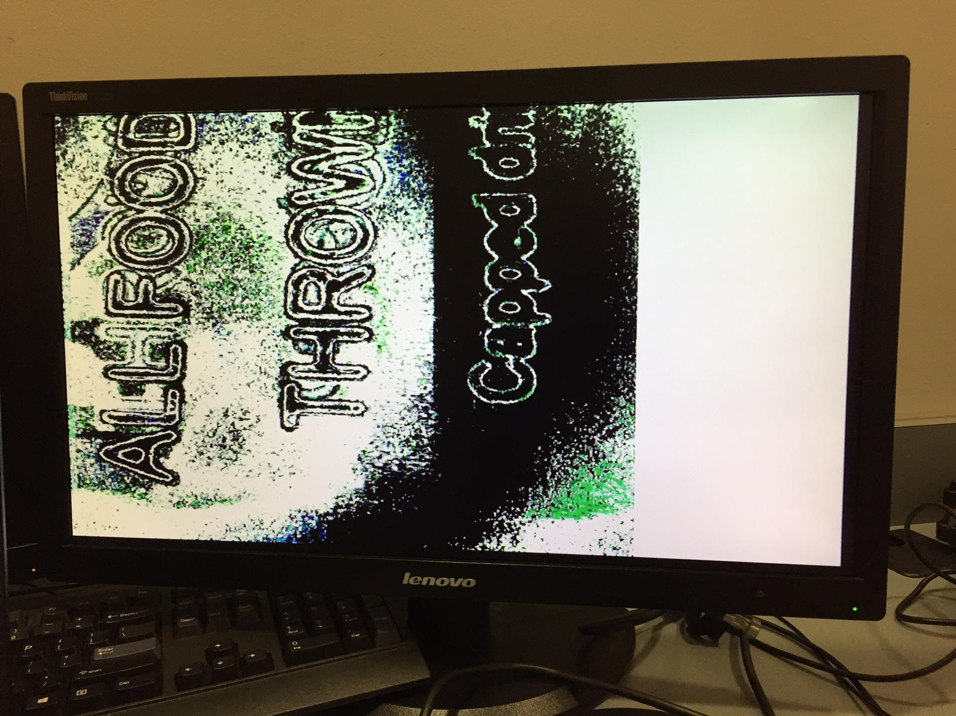
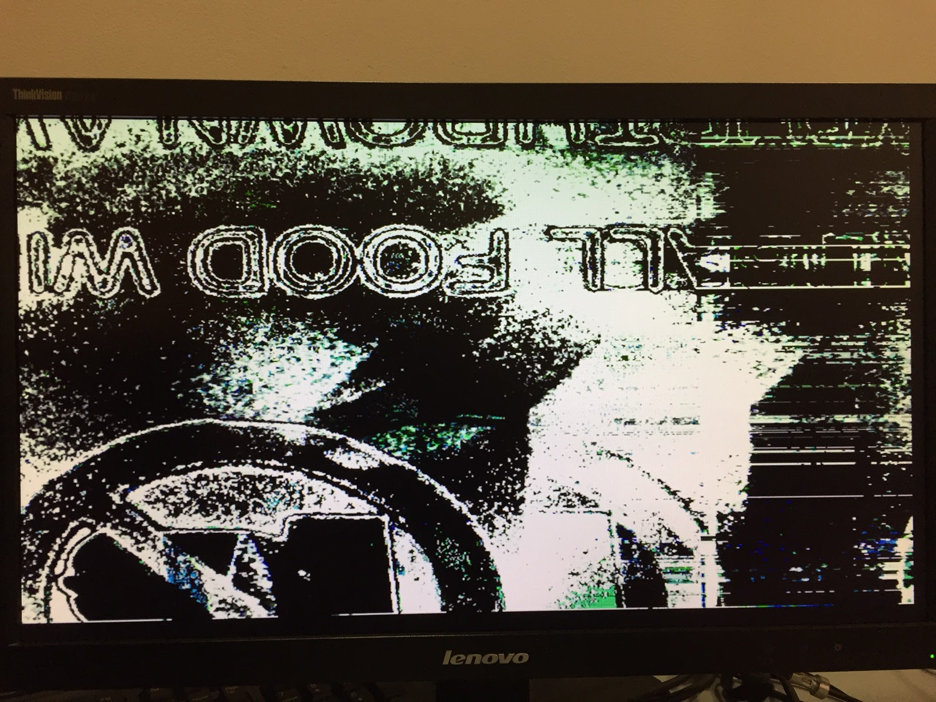
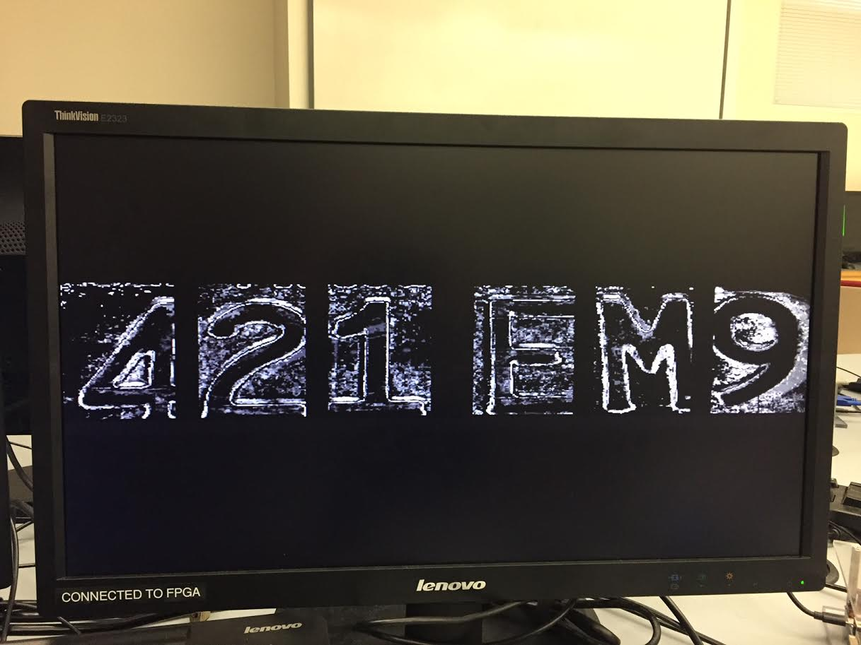
Successes
Frame data streamed from camera and displayed on VGA.
Fixed most timing issues
Window module implementing edge detection.
Experimented with a variety of filters to find best results for our implementation.
Basic segmentation
Recognition infrastructure

Slide 29
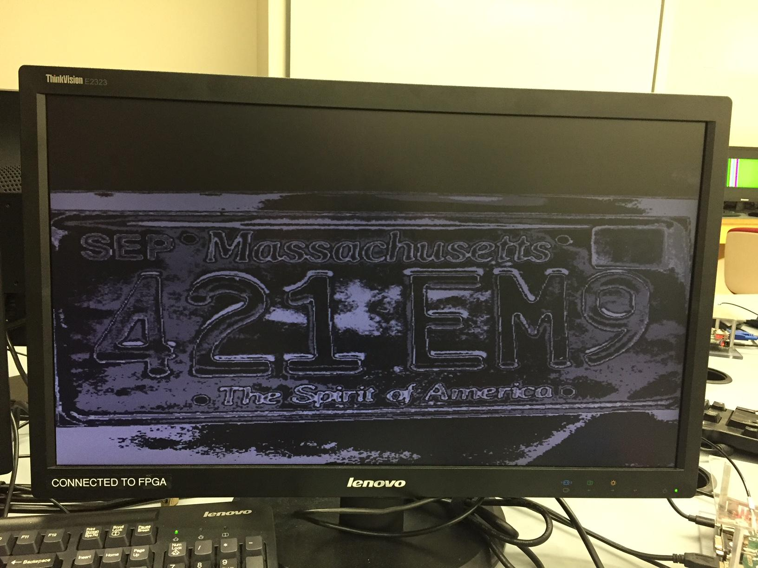
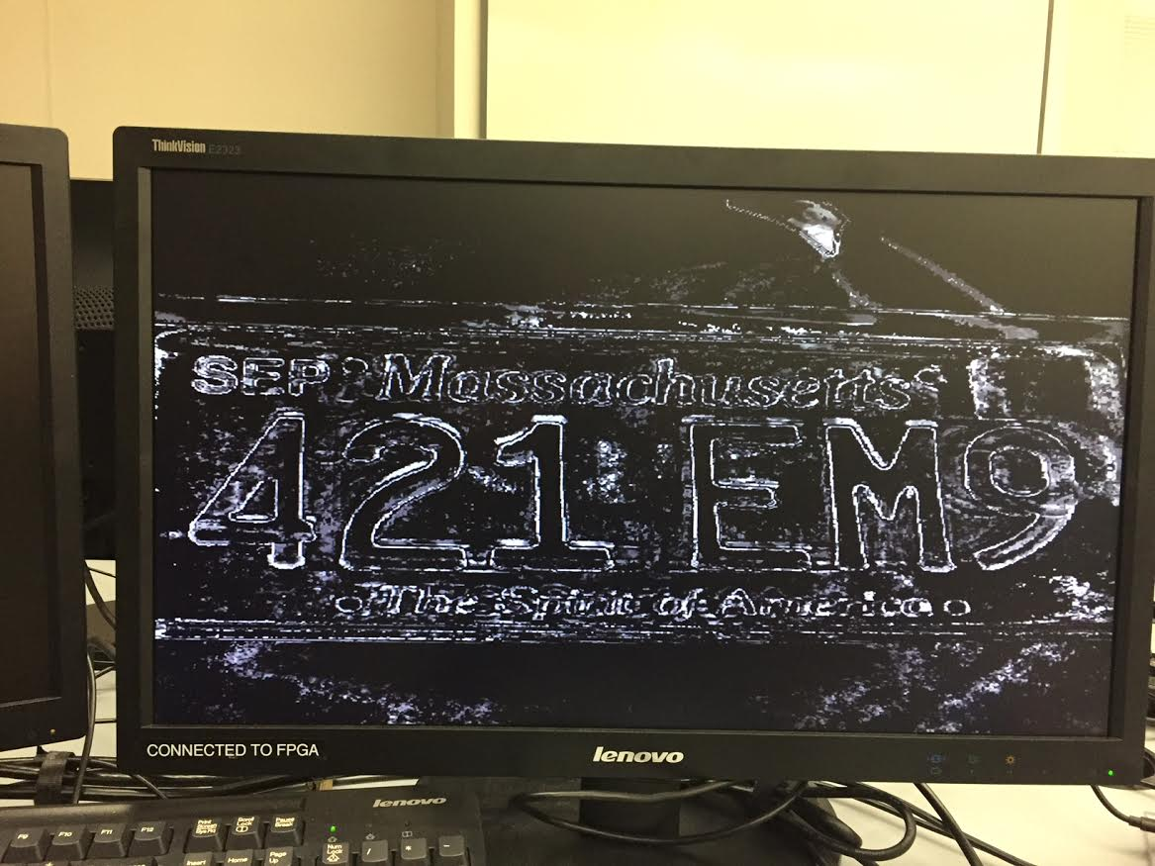
Failures
Edge detected image very noisy.
Dynamic character segmentation.
Working OCR on FPGA.
Grayscale identity output
Edge detection output

Slide 30
Video Demonstration
https://drive.google.com/drive/folders/0B0UC3LLTtkG2cVFLYTJyVndhSnc

Slide 31
Work Split
Camera to VGA - Joe, Patrick
Window Module - Darin, Jack, Patrick
UART Testing
Segmenting Module - Ravi, Joe, Patrick, Darin, Jack
MATLAB testing
OCR Attempt - Joe, Darin, Ravi
Memory Integration Attempt - Jack
Block and DDR
CPU Integration Attempt - Ravi
Overall, we felt the workload was split evenly.

Slide 32
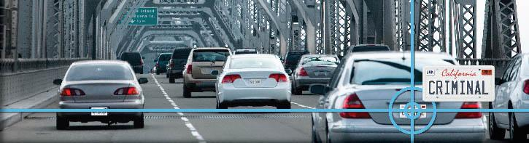
Thank you!
Notes:
Image from: https://axiomamuse.files.wordpress.com/2011/03/alprheader_image_placeholder.jpg

